Slide 1
BOULEVARD BOLT 2022

Slide 2
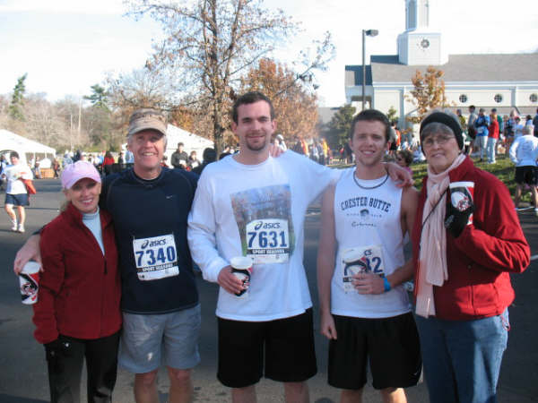
WORKING TOGETHER
Imagine a world where Baptists, Jews and Episcopalians come together to help meet a critical need in the Nashville community – serving the homeless.

Slide 3
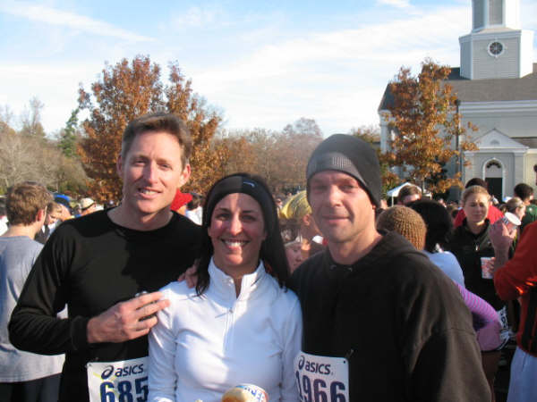
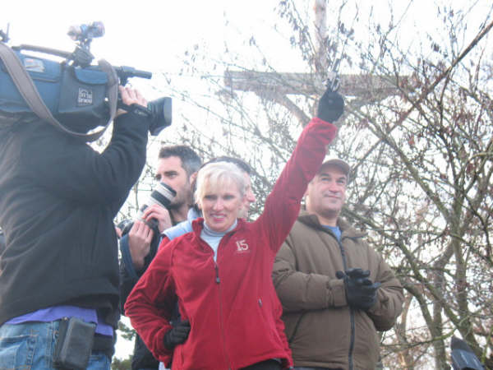
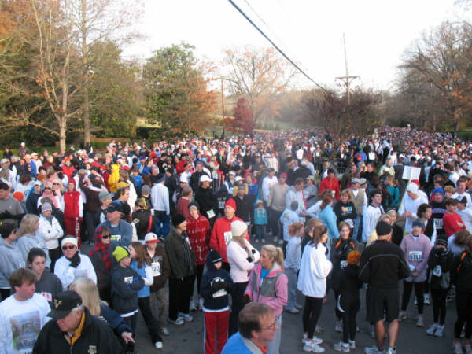
THE BOULEVARD BOLT
A Nashville Thanksgiving Day tradition since 1994
The largest 5-mile race in the country
Donated over $4.3 million to the homeless since inception

Slide 4
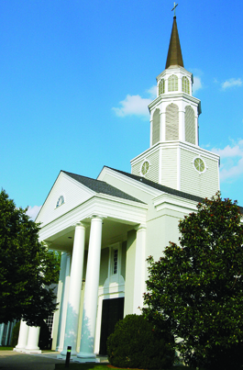
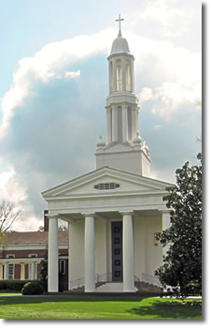
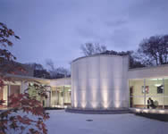
BOULEVARD BOLT SPONSORS
The Boulevard Bolt is presented each year by volunteers from:
St. George’s Episcopal Church
Immanuel Baptist Church
The Temple Congregation Ohabai Sholom

Slide 5
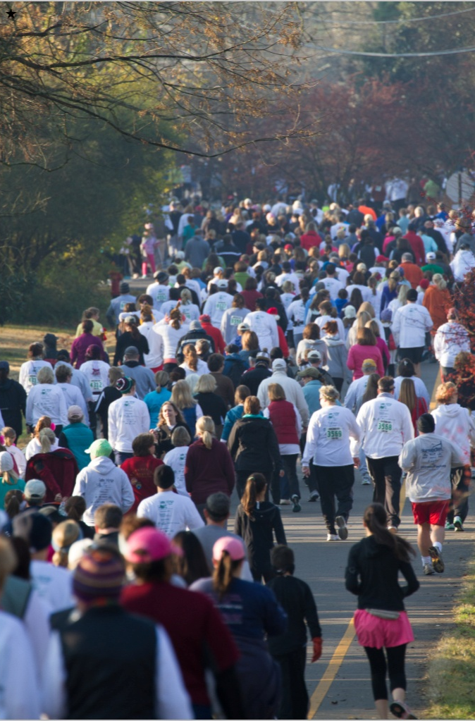
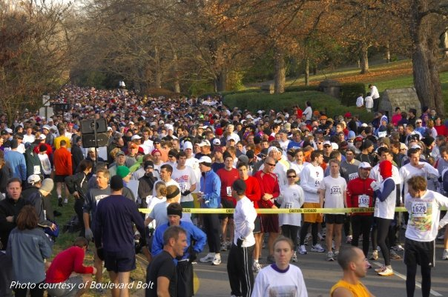
GROWTH AND IMPACT
Since 1994, the Boulevard Bolt has grown from 2,500 participants to over 8,200 participants!

Slide 6
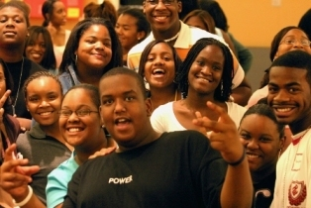
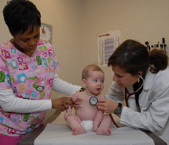
ALLOCATIONS
All Nashville agencies that benefit the homeless are invited to apply for funds
Applicants must state intended use of the funds and specific amount required
Requested funds must be for specific projects, not general operating costs
An allocations committee with members from each congregation determines the priority for funding

Slide 7
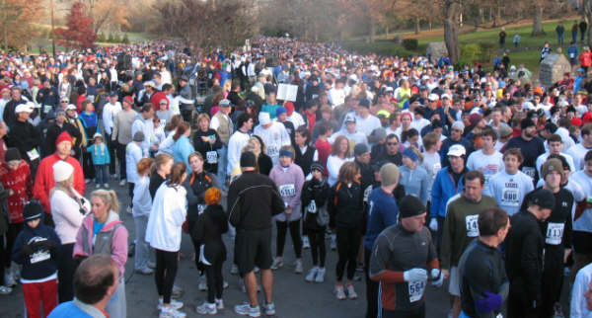
VOLUNTEER DRIVEN
The efforts of many people make the annual Boulevard Bolt possible. Volunteer committees led by members of each congregation coordinate the preparation and race day events. In addition, many generous individuals, organizations and corporations sponsor The Boulevard Bolt and ensure that the funds are raised to help the homeless.

Slide 8
2022 SPONSORSHIP OPPORTUNITIES
$15,000 EXCLUSIVE Signature Sponsor
EXCLUSIVITY – No other sponsors will be in the same line of business.
EXCLUSIVE sponsor name/logo on the Start/Finish banner.
EXCLUSIVE sponsor logo printed on each race bib number.
Prominent name/logo in large type on the race t-shirt – NOTICEABLY LARGER than other sponsors.
Prominent name/logo in large type on print media – NOTICEABLY LARGER than other sponsors.
Prominent name/logo in large type on website – NOTICEABLY LARGER than other sponsors.
Prominent recognition on large thank you banner displayed at registration tent on race day.
Recognition on race day by the race announcer and speaker.
25 complimentary registrations and 2 VIP parking passes.
Expedited VIP registration/t-shirt/race number pick-up.
$10,000 EXCLUSIVE Diamond Sponsor
EXCLUSIVE sponsor name/logo on the five-mile marker flags on race day.
Prominent name/logo in large type on the race t-shirt – NOTICEABLY LARGER than the lower-level sponsors.
Prominent name/logo in large type on print media – NOTICEABLY LARGER than the lower-level sponsors.
Prominent name/logo in large type on website – NOTICEABLY LARGER than the lower-level sponsors.
Recognition on large thank you banner displayed at registration tent on race day.
Recognition on race day by the race announcer and speaker.
15 complimentary registrations and 1 VIP parking pass.
Expedited VIP registration/t-shirt/race number pick-up.

Slide 9
2022 SPONSORSHIP OPPORTUNITIES
$7,500 Platinum Sponsor
Prominent name/logo in large type on the race t-shirt – NOTICEABLY LARGER than the Gold and Silver sponsors.
Prominent name/logo in large type on print media – NOTICEABLY LARGER than the Gold and Silver sponsors.
Prominent name/logo in large type on website – NOTICEABLY LARGER than the Gold and Silver sponsors.
Prominent recognition on three flag banners at pre and post event space on race day.
Recognition on race day banner and by the race announcer and speaker.
10 complimentary registrations with expedited VIP registration/t-shirt/race number pick-up.
$5,000 Gold Sponsor Level
Prominent name/logo in large type on the race t-shirt – NOTICEABLY LARGER than the Gold and Silver sponsors.
Prominent name/logo in large type on print media – NOTICEABLY LARGER than the Gold and Silver sponsors.
Prominent name/logo in large type on website – NOTICEABLY LARGER than the Gold and Silver sponsors.
Recognition on race day banner and by the race announcer and speaker.
8 complimentary registrations.
Expedited VIP registration/t-shirt/race number pick-up.
$2,500 Silver Sponsor Level
Name/logo on the race t-shirt.
Name/logo on print media and website.
Recognition on race day by the race announcer.
5 complimentary registrations with VIP registration pick-up.
$1,000 Bronze Sponsor Level
Name/logo on website and poster.
Recognition on race day by the race announcer and thank you banner.
2 complimentary registrations.

Slide 10
PAST DESIGNATED RECIPIENTS
510 Foundation
Aphesis House, Inc.
Building Lives Foundation
Clinic at Mercury Courts
Colby’s Army, Inc.
Communities in Schools of Tennessee
Community Resource Center
Connect Us Outreach Ministry
The Contributor
Davidson Co. Mental Health Court & Veterans Treatment Court Foundation
Dismas House
Faith Family Medical Clinic
Hope Station, Inc.
How’s Nashville Partner Agencies
Ladies of Charity Nashville
Loaves & Fishes
Luke 14:12
Magdelene (Thistle Farms)
Matthew 25, Inc
Monroe Harding
Morning Star Sanctuary, Inc.
Nashville Conflict Resolution Center
Nashville Diaper Connection
The Nashville Food Project
NeedLink Nashville
Neighborhood Health
Nurses for Newborns of Tennessee
Oasis Center, Inc.
Open Table of Nashville
Operation Stand Down Nashville
Park Center
Penuel Ridge Retreat Center
Prevent Child Abuse
Project Return
Renewal House
Rooftop Foundation
Room in the Inn
Safe Haven Family Shelter
Second Harvest Food Bank
Shade Tree Family Clinic
Shower the People
Siloam Family Health Center
St. Luke’s Community House
TN Coalition to End Domestic and Sexual Violence
The Joe Beretta Foundation
The Next Door
Youth Villages of Middle Tennessee
YWCA of Nashville & Middle Tennessee

Slide 11
2021 CORPORATE SPONSORS
Signature Sponsor
FirstBank
Diamond Sponsor Platinum Sponsor
Frank E. Neal & Co. AllianceBernstein
Gold Sponsors
DVL Seigenthaler/ FINN Partners Pilkinton Eye Center
Pinnacle Financial Partners Raymond James
Silver Sponsors
Castle Homes, Gluck Orthodontics, Gorham & Armarell Dentistry, Hermitage Design Center, INSBANK, K&L Gates, Petra Capital

Slide 12
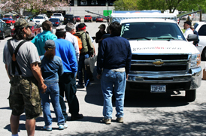
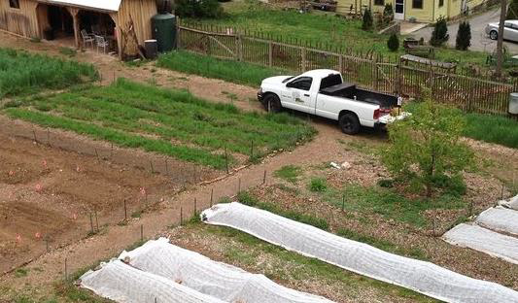
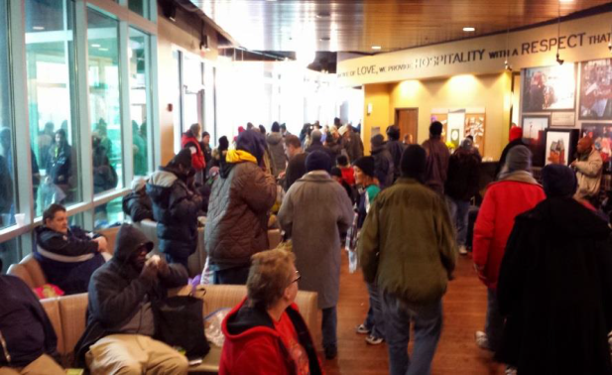
COMMUNITY BENEFIT
Proceeds from the 2022 Boulevard Bolt were used to…
Provide funds to operate a food truck to deliver hot meals to the homeless on the streets
Support a vaccine outreach program for homeless and uninsured
Purchase backpacks with “street survival supplies” for homeless youth
Build a community garden with fresh produce to support a feeding program
Provide bags of nutritious food for children to take home from school on the weekend
Support job training programs for homeless veterans
Provide mobile showers and hair cuts for homeless individuals
….and many other much needed services

Slide 13
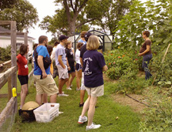
MAKING A DIFFERENCE
The Boulevard Bolt is more than just a race, but an opportunity to celebrate the season of giving and serve those less fortunate in the Nashville community.
For further information on being a 2022 Boulevard Bolt Sponsor please
contact Molly Craig at molly@boulevardbolt.org

